Slide 1

Computer Engineering Department
A.P. Shah Institute of Technology
G.B.Road, Kasarvadavli, Thane(W), Mumbai-400615
UNIVERSITY OF MUMBAI
Academic Year 2019-2020

Slide 2
A Project Report on
Histopathologic Cancer Detection
Submitted in partial fulfillment of the degree of
Bachelor of Engineering in Computer Engineering
By
Mr. Ketan Muddalkar (16102022)
Mr. Rohan Dhere (15102057)
Under the Guidance of
Prof. Pravin Adivarekar

Slide 3
1.Project Conception and Initiation
Cancer is a group of diseases involving abnormal cell growth with the potential to invade or spread to other parts of the body.
Cancer is the second most common disease in India responsible for maximum mortality with about 0.3 million deaths per year
Purpose of our project is to develop a system that can automatically detect cancer from the blood cell images.

Slide 4
1.1 Abstract
In this project we aim to classify cancer images with maximum accuracy using deep learning techniques like Convolutional Neural Network(CNN).
After achieving desired accuracy we deployed the model on the web using Amazon Web Services.
The dataset which we are using contains 2 classes, class one consist of images of cancer-free patients and class two consist of images of patient having cancer.
We are working with 3 models which are ensembled to get better accuracy

Slide 5
1.2 Objectives
Create Deep Learning model that will accurately detect cancer from the histopathologic images.
To make process smoother and fluent propose a model which will help doctors in taking decision correctly & accurately.
Deploy the model on internet which will serve as a base for hospitals in the direction of fully digitizing their organization.
Generating a medical report based on the result predicted by the model

Slide 6
1.3 Literature Review
The performance of the deep learning network models depends on overall task at hand, dataset used, evaluation setup and much more.
The most prevalent way to perform transfer learning is to employ a pre-trained model and to fine tune it with data at hand.
Other approach is to use a pre-trained model as a feature extractor and perform further classification with a seperate classifier.
One of the transfer learning approach is to use an architecture that has done well in other tasks and to train it from scratch.

Slide 7
1.4 Problem Definition
Cancer arises from the transformation of normal cells into tumour cells in a multistage process that generally progresses from a precancerous lesion to a malignant tumour if undetected.
Cancer cells are hard to detect for human eyes even for a professional pathologist.
Hence with the help of this deep learning method we intend to speed-up the process of cancer detection with high accuracy and hence contribute towards reduction in number of deaths caused due to cancer.

Slide 8
1.5 Scope
The project will involve gathering data from hospitals or websites.
Planning to deploy the model on a website which can act as an example for hospitals to create a similar portal for the benefits mentioned.
The scope of this project is to deliver a model, with world-class accuracy, which can detect cancer from histopathology images and produce top notch results.

Slide 9
1.6 Technology stack
Languages
PHP, Python, HTML, CSS, MySQL
Libraries
Tensorflow, Keras, Pandas, NumPy, OpenCV, Bootstrap
Environments/ Tools
Apache Server, Google Colab, Nvidia DGX, Amazon Web Services.

Slide 10
1.7 Benefits for environment & Society
Training several large machine learning models with approximately 100 million parameters will have carbon footprint of roughly 600 kg also tuning them will require significant amounts of energy.
To reduce this amount we’ll be using an approach of transfer learning where pretrained models can be used to train on a new dataset.
This method is computationally inexpensive which can save a lot of energy and help the environment.

Slide 11
2. Project Design

Slide 12
2.1 Proposed System
The image which is submitted on the webpage by a patient will be saved at backend after storing it this image will be preprocessed too
For the training we are using deep learning techniques like Convolutional Neural Network(CNN).
We are working with 3 best models which are ensembled to get better accuracy compared to a single model.
A final report is getting generated based on the results predicted by the model and this report is saved at the backend

Slide 13
2.2 Design(Modules)
Front End.
Dataset.
CNN Model.
Back End.

Slide 14
2.3 Description Of Use Case
Login
Create Login
Upload Image
Detection
View Output/Report
Logout

Slide 15
2.5 Module 1:- Front End
The website will act as a portal for both hospitals and patients.
From the account, the user will have the option to upload the reports for diagnosis.
Front end will include HTML, CSS which is designed using Bootstrap

Slide 16
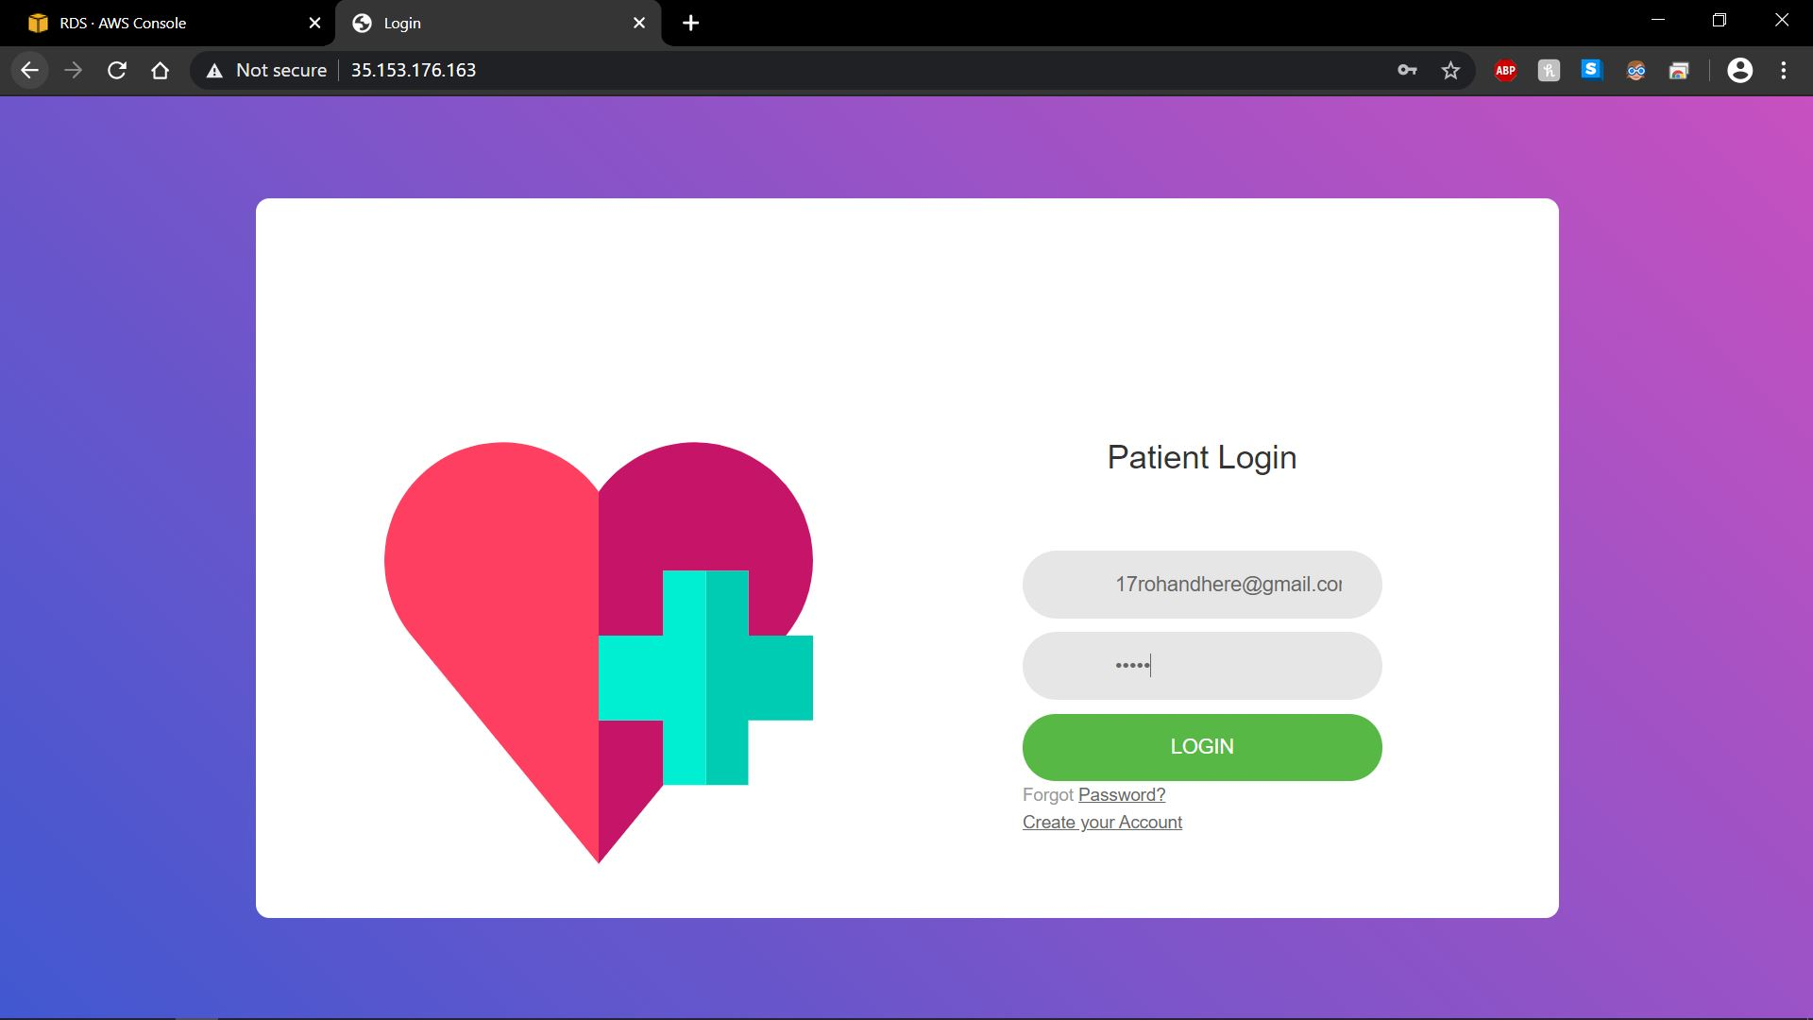

Slide 17
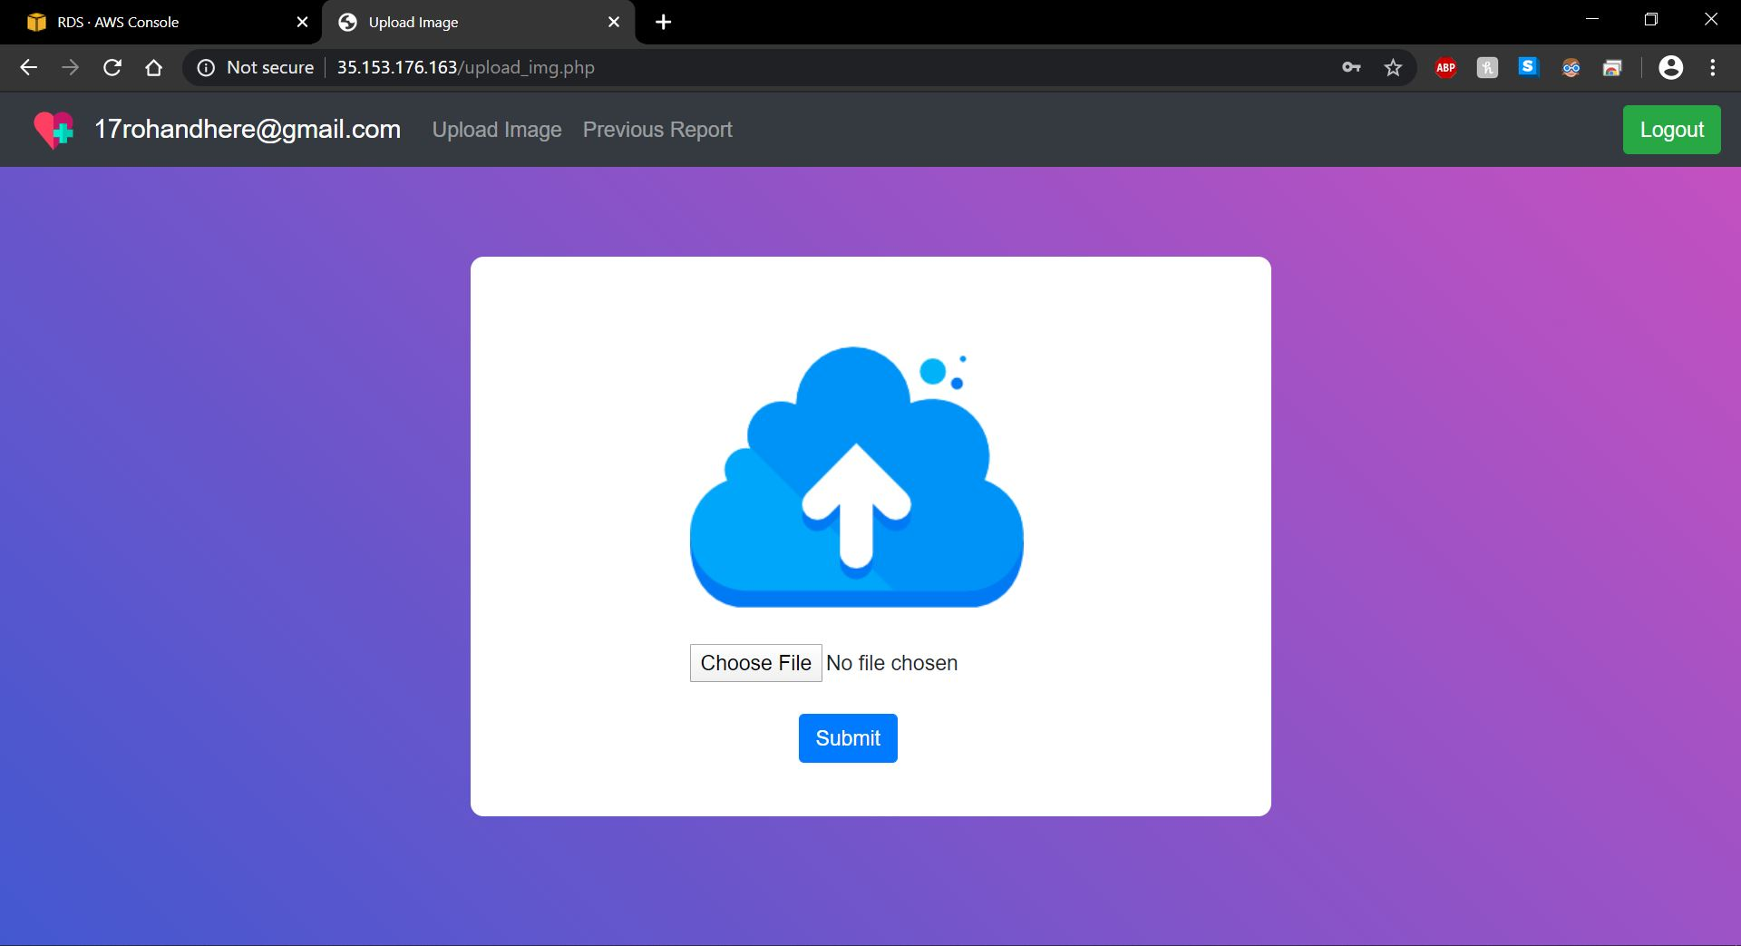

Slide 18
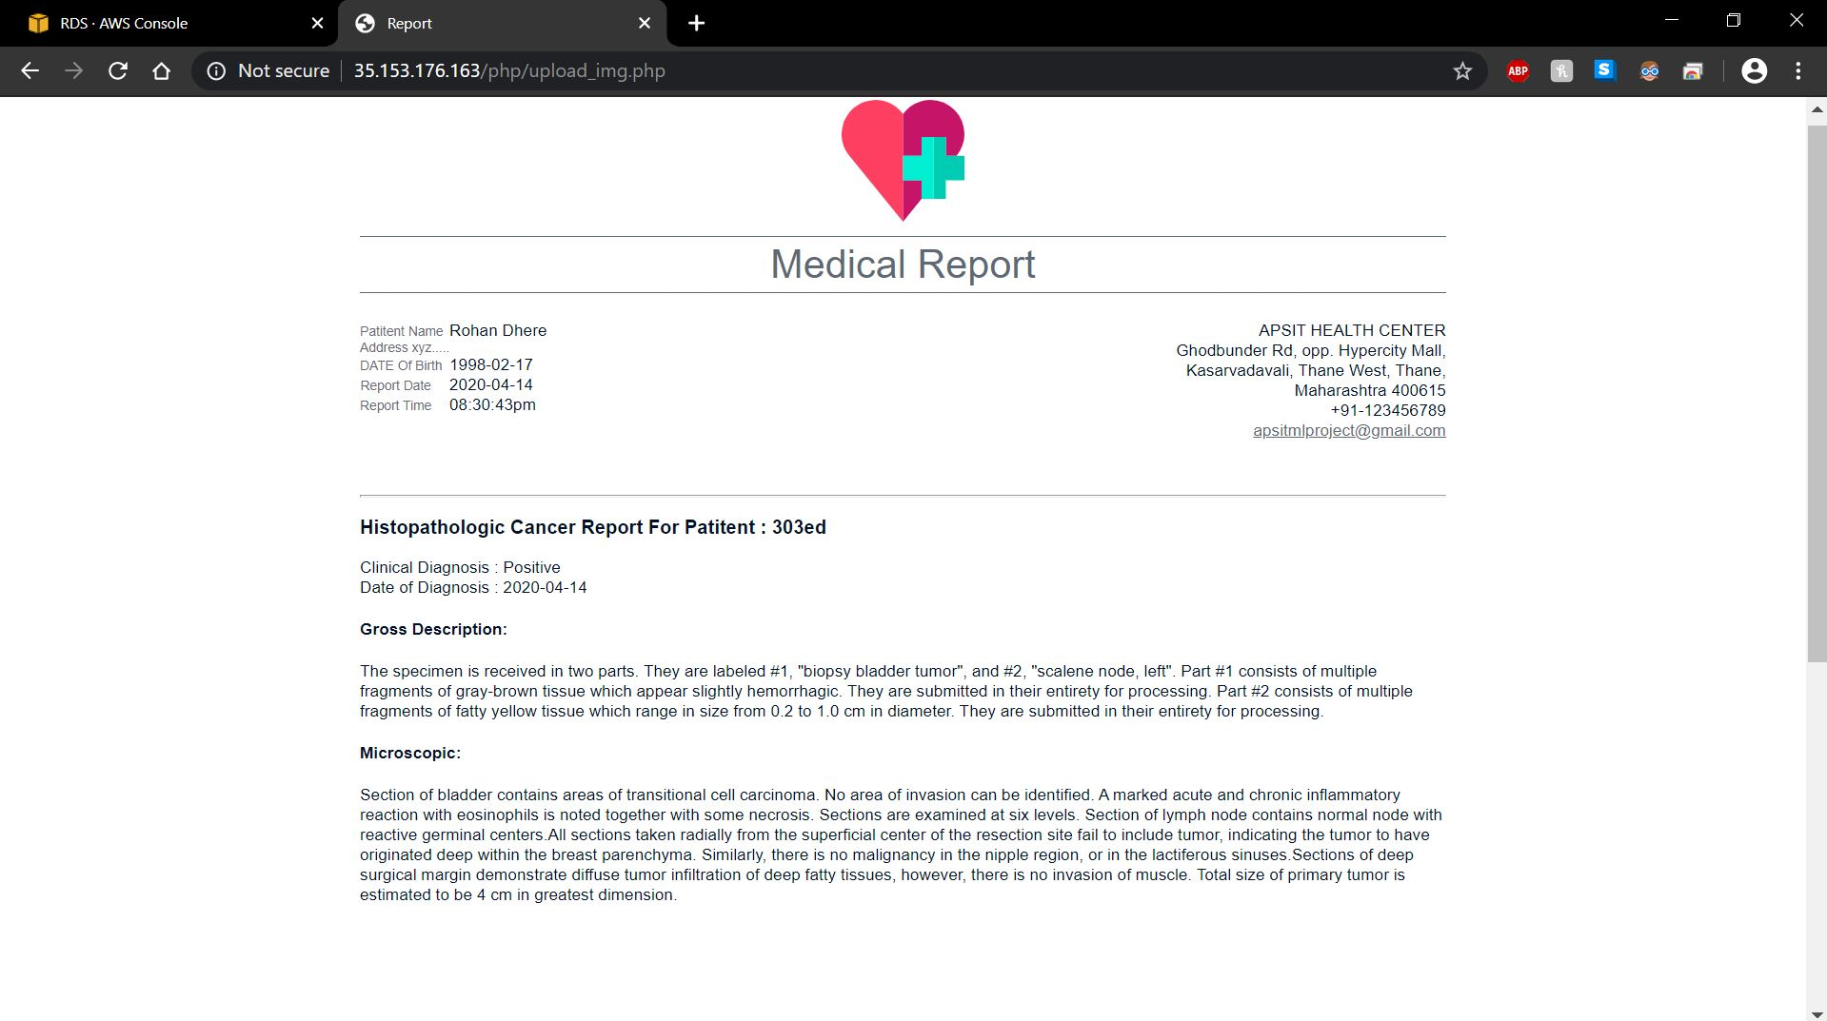

Slide 19
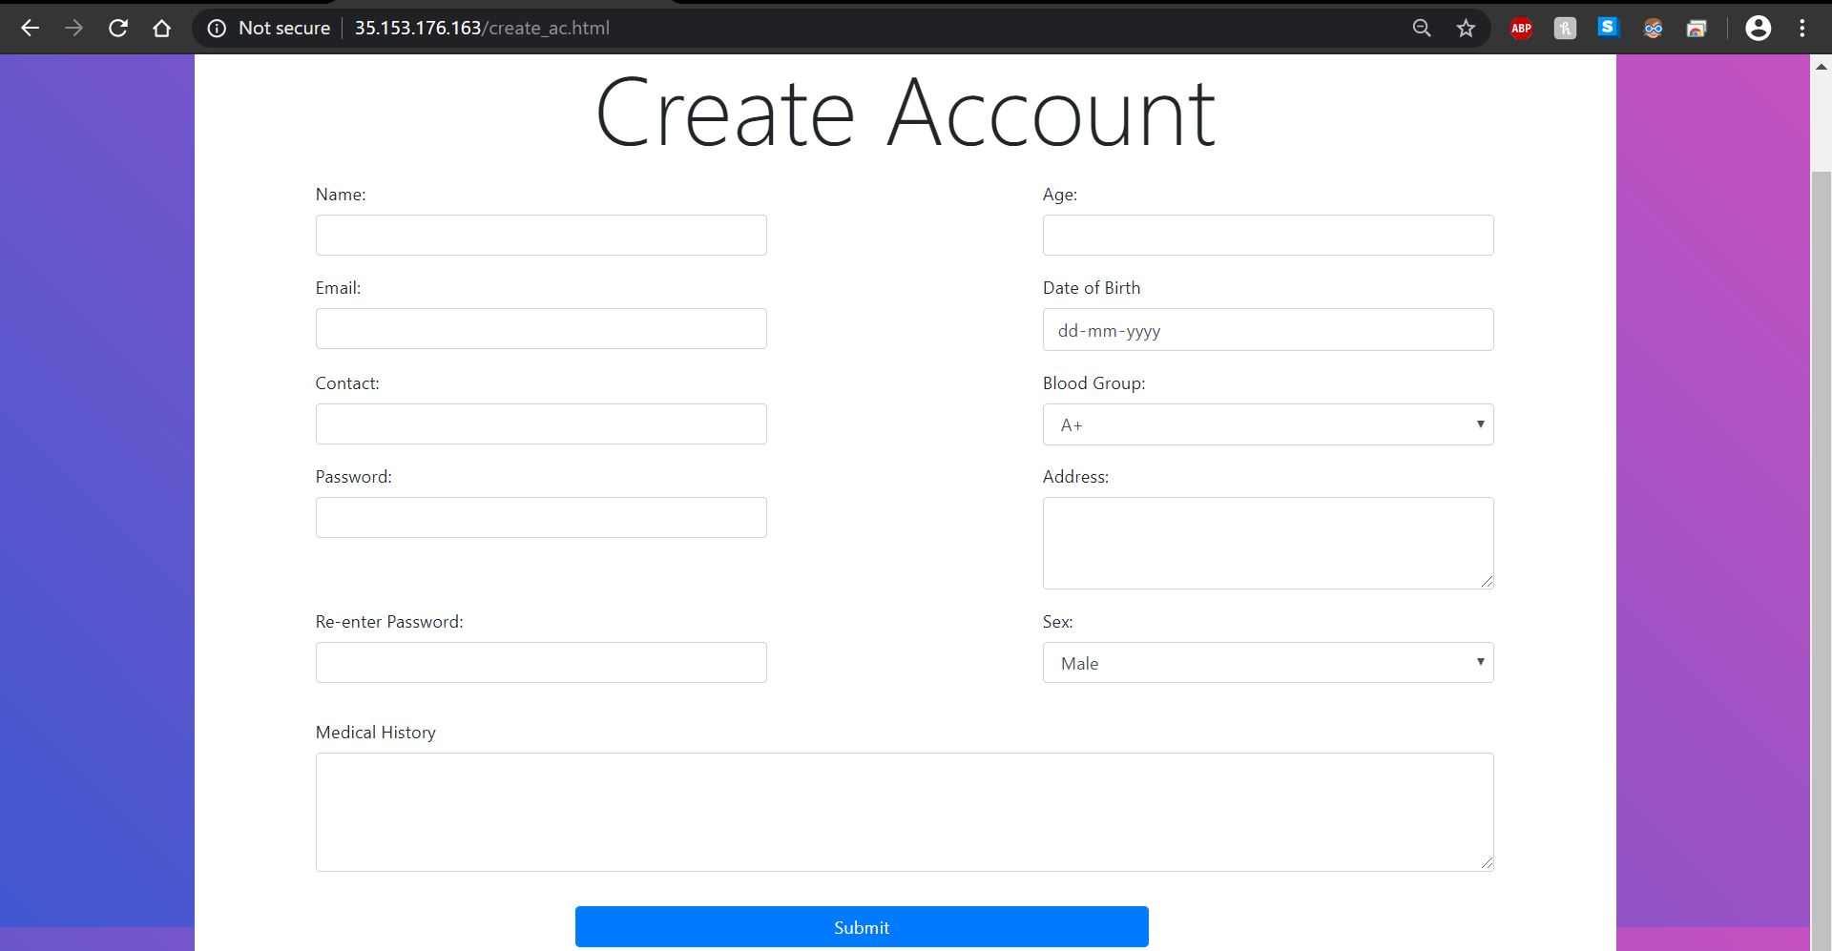

Slide 20
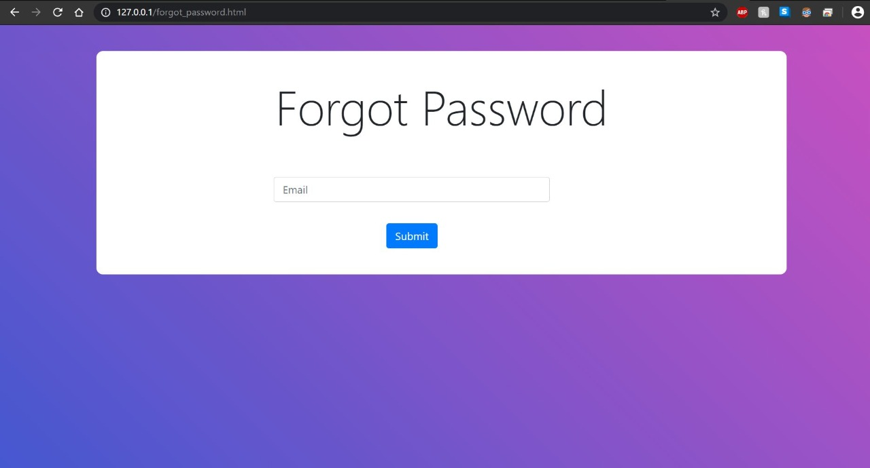

Slide 21
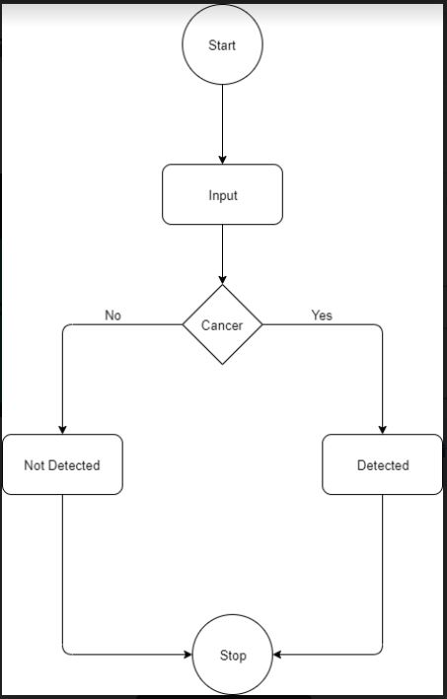
Activity diagram

Slide 22


Module 2.6 :- Dataset
Understanding the Data
Modified version of the PatchCamelyon (PCam) benchmark dataset.
The dataset contains a total of 2.2 lakh images of cancer cells.
All of the images are 92x92 pixels in size.
Healthy Cell
Cancer Cell

Slide 23
Data Preprocessing
Parameter | Value
Horizontal Flip | True
Vertical Flip | True
Rotation Range | 90
Zoom Range | 0.2
Width Shift Range | 0.1
Height shift Range | 0.1
Shear Range | 0.05

Slide 24
Module 2.7 :- ConvNet
This model will be responsible to predicting the result from the image given by the user
This is where data pre-processing comes into the picture
The model will be trained on these images.
After achieving desired accuracy, the model will be allowed to predict the outcome for the input provided by the user.

Slide 25
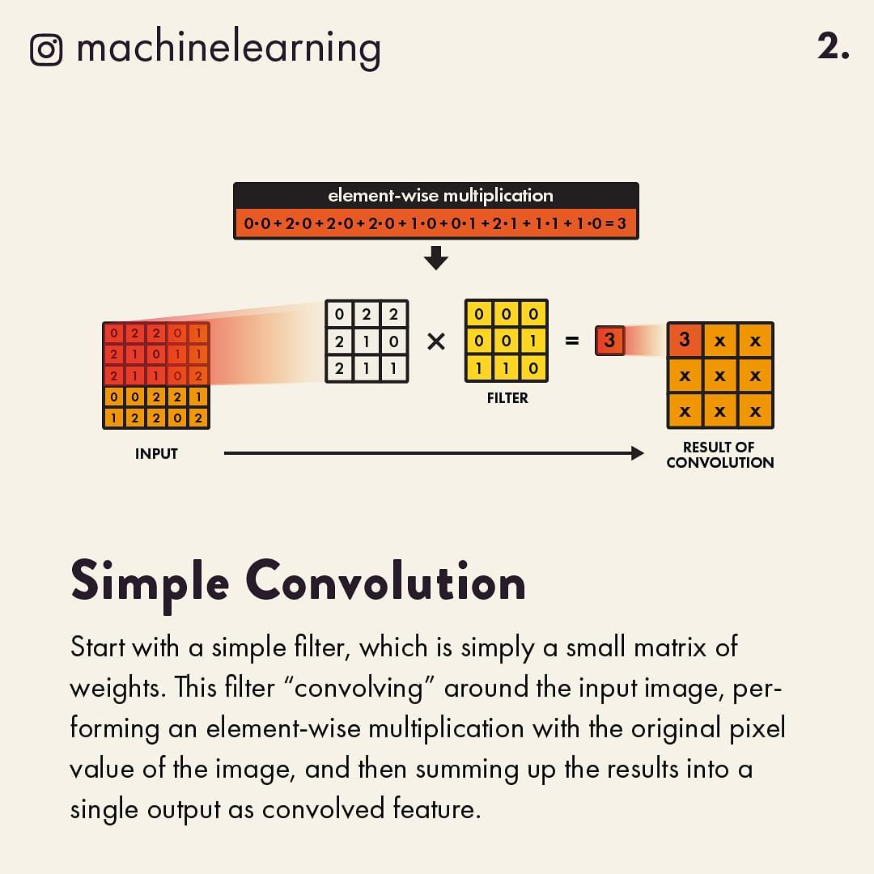
Convolution Function

Slide 26
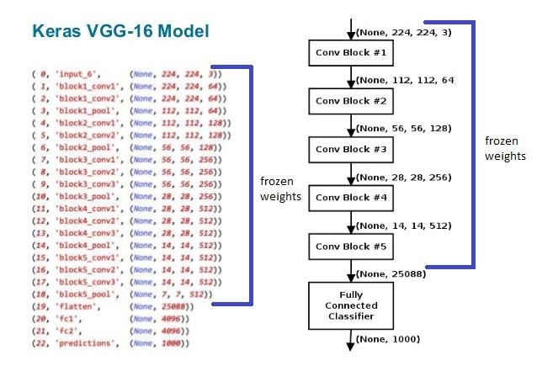
Architecture of ConvNet

Slide 27
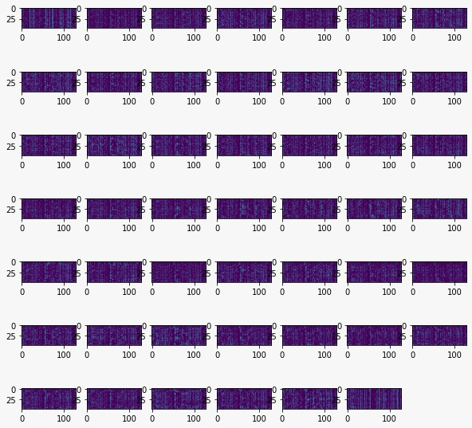
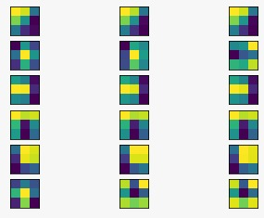
Visualization
Filters Visualization
Layers Visualization

Slide 28
Module 2.7 :- Back-end
This part is consists of a web server, model, the database with all the user information and generation of user’s medical report.
AWS Services Used :
Ec2 instance (Elastic Compute Cloud).
Amazon RDS(Amazon Relational Database Service).
VPC (Virtual Private Cloud).

Slide 29
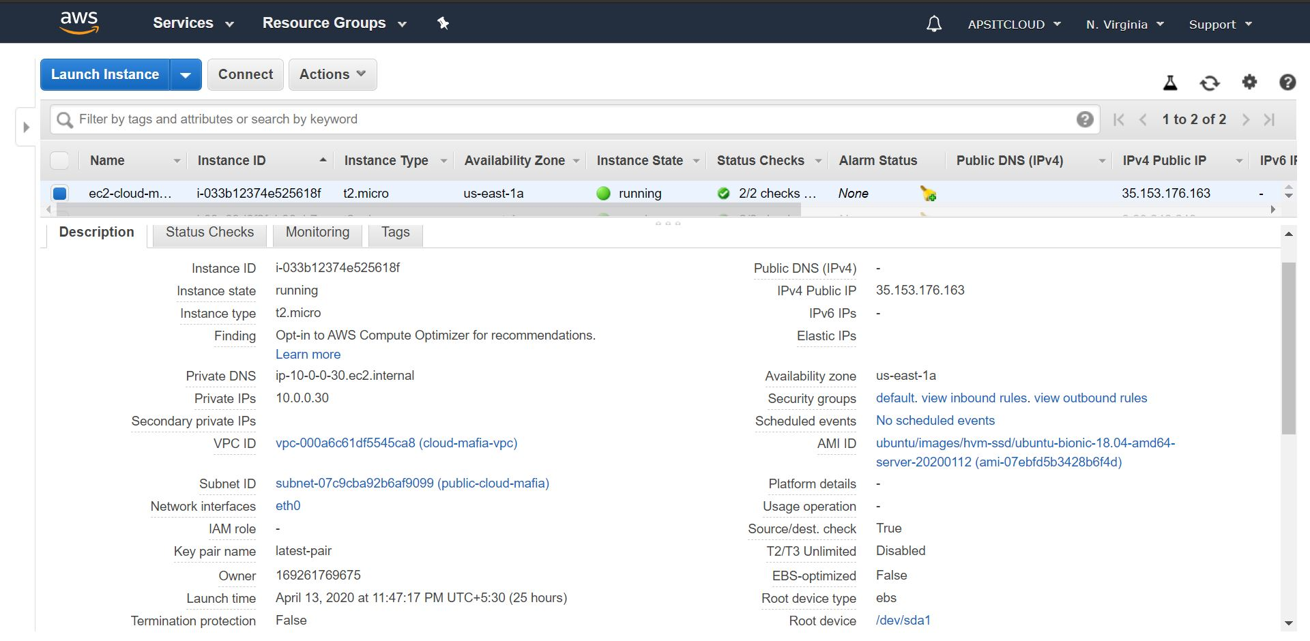
EC2 Configuration

Slide 30
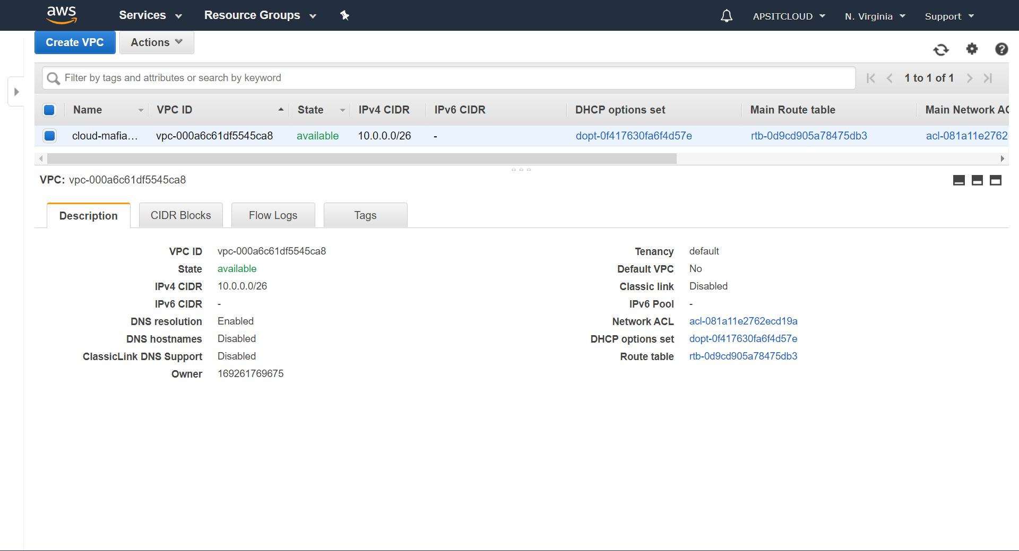
Virtual Private Cloud Configuration

Slide 31
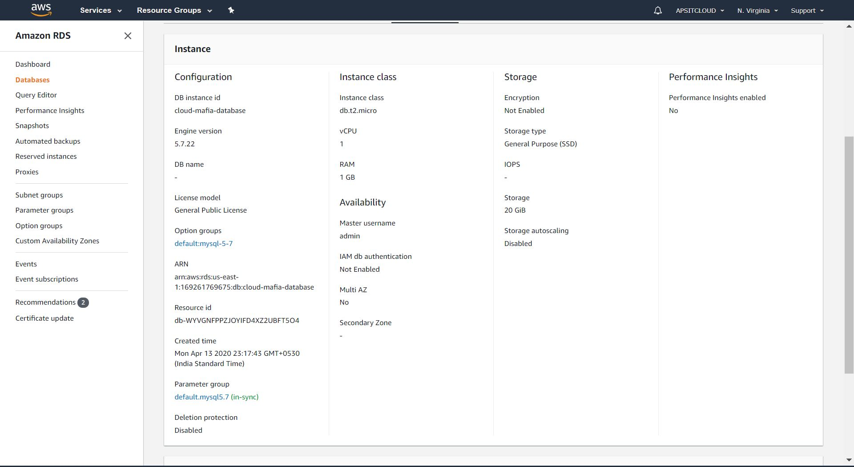
Relational Database Configuration

Slide 32
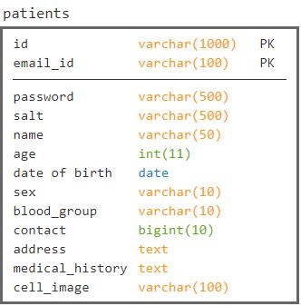
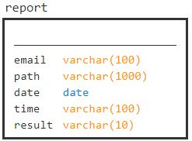
Tables in Database

Slide 33
3. Results

Slide 34
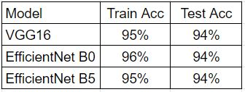
3.1 Results
We have used 3 CNN architecture, VGG16, Ecient Net B0 and Efficient Net B5.
All these 3 models were ensembeled and their cumulative accuracy was 96%.

Slide 35
4. Conclusion

Slide 36
4.1 Conclusion
Individual accuracies of ConvNet models were low compared to the accuracy of the ensembled network’s accuracy.
Compared to a pathologist our system can generate results faster.
Proposed system should act as an assistant rather than a decision-maker.

Slide 37
5. Future Scope

Slide 38
5.1 Future Scope
Our system can be deployed on the portal of hospitals and can be used to assist oncologists to detect cancer.
Similar models can also be trained to detect different types of cancers if the proper dataset is provided.
An offline application interface can be created to use our system in the case of the unavailability of an internet connection.
Such a system would be very useful in rural areas.

Slide 39
6. References
Bardou, D., Zhang, K. and Ahmad, S.M., 2018. Classification of breast cancer based on histology
Images using convolutional neural networks. IEEE Access, 6, pp.24680-24693.
M. C. Chun. (2018). Breast Cancer: Symptoms, Risk Factors, and Treatment, Medical News Today. Accessed: Mar. 10, 2018.
L. He, L. R. Long, S. Antani, and G. R. Thoma, ‘‘Histology image analysis for carcinoma. detection and grading,’’ Comput. Methods Programs Biomed., vol. 107, no. 3, pp. 538–556, 2012.
P. Filipczuk, T. Fevens, A. Krzyzak, and R. Monczak, ‘‘Computer-aided breast cancer diagnosis based on the analysis of cytological images of fine needle biopsies,’’ IEEE Trans. Med. Imag., vol. 32, no. 12, pp. 2169–2178, Dec. 2013.
M. Veta, J. Pluim, P. van Diest, and M. Viergever, ‘‘Breast cancer histopathology image analysis: A review,” IEEE Trans. Biomed. Eng., vol. 61, no. 5, pp. 1400–1411, May 2014.

Slide 40
Thank You

